Slide 1
Project Progress Review
Road Traffic Management System
By:
Traffic 24 Team
Members
M.M. Irfan (S92065814).
P. Komathy (S92065503).
P. Pirathapan (S92068465).
S. Thanujan (S18007700).

Slide 2
Project Introduction
Purpose of the project
To improve poor transport operation, reduce traffic jam and provide sufficient driving training ethic and law enforcement.
Scope of the project
Road Traffic Management system is a hi quality graphical module and provide premium quality of traffic violation detection and real time Traffic flow metrics.

Slide 3
Progress of project
Group forming
Monthly meeting report
Information gathering of project
Requirement elicitation
Identify the client
Software architecture of the project

Slide 4
Attention Area
Delays and Problems
Getting appointment with client
Group members are living different district and on site meeting not possible
All group members are committed with their career and difficult to meet them certainly

Slide 5
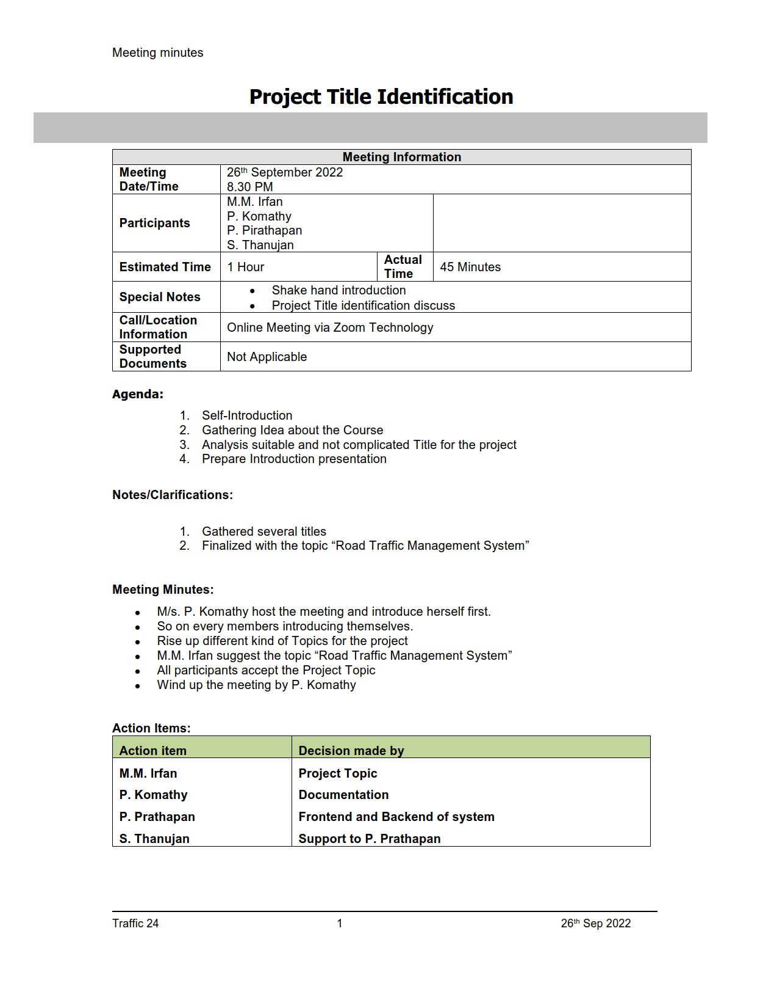
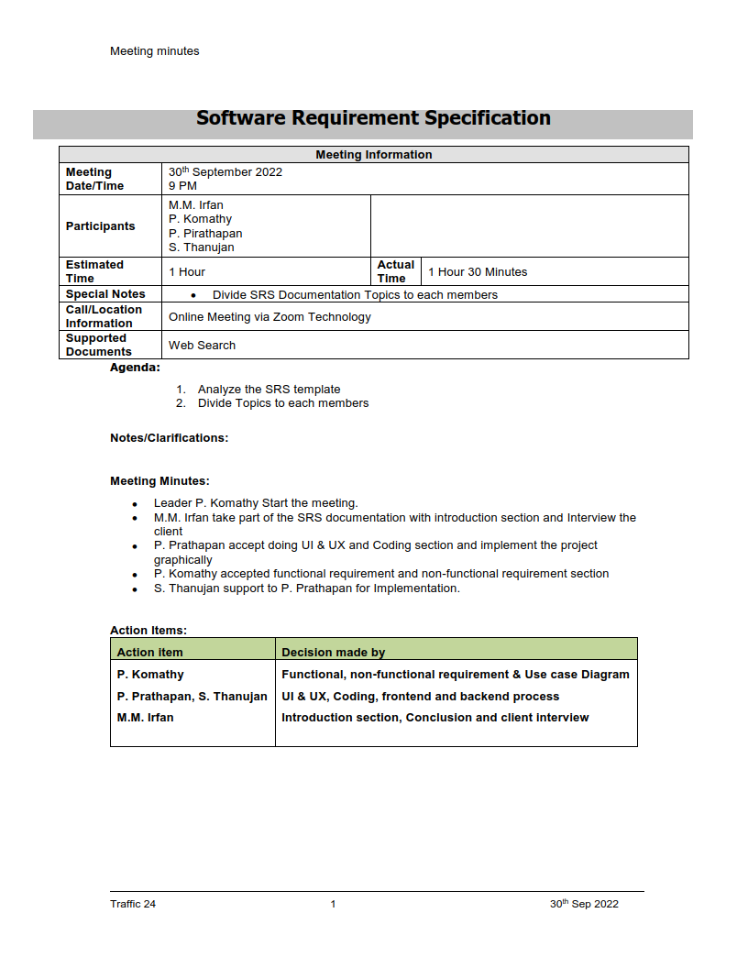
Meeting Minutes
Meeting - 1
Meeting - 2

Slide 6
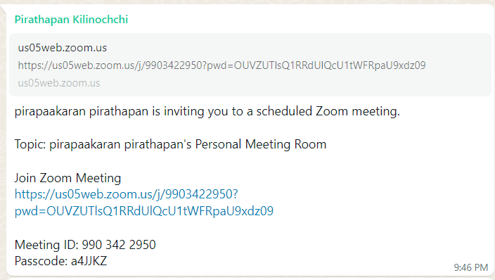
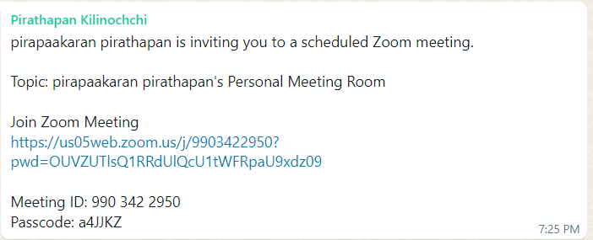
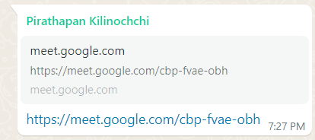
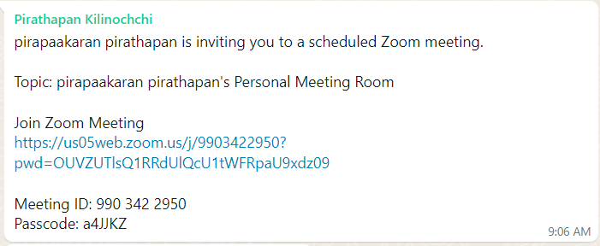
Meeting Minutes

Slide 7
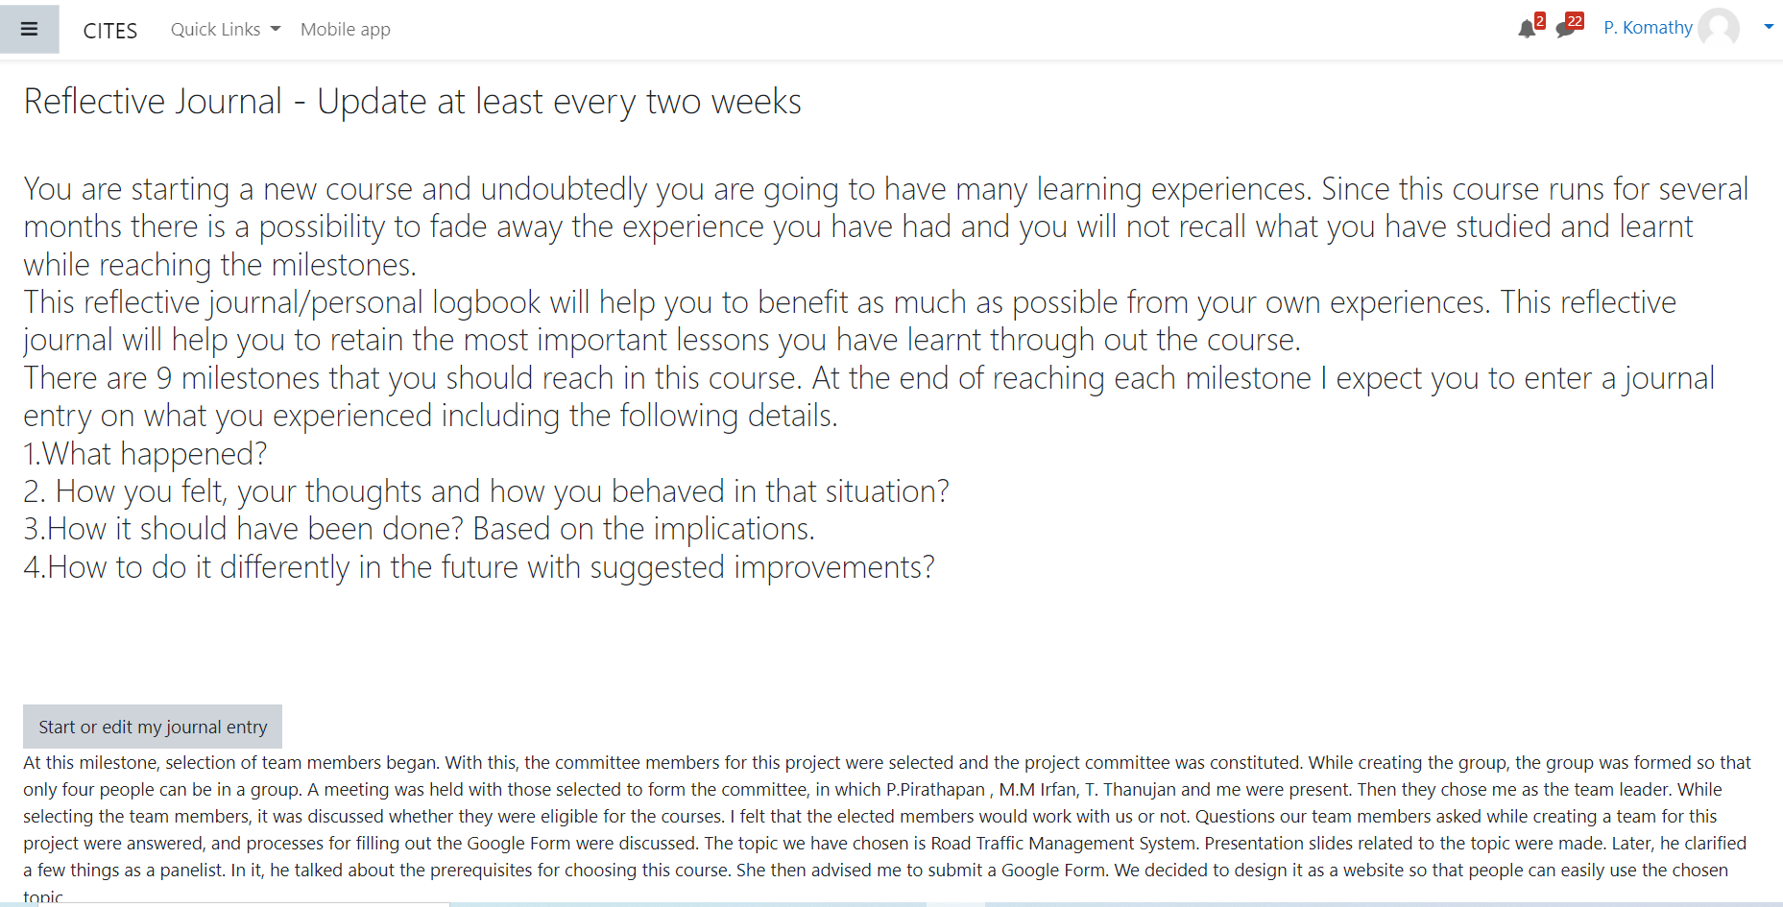
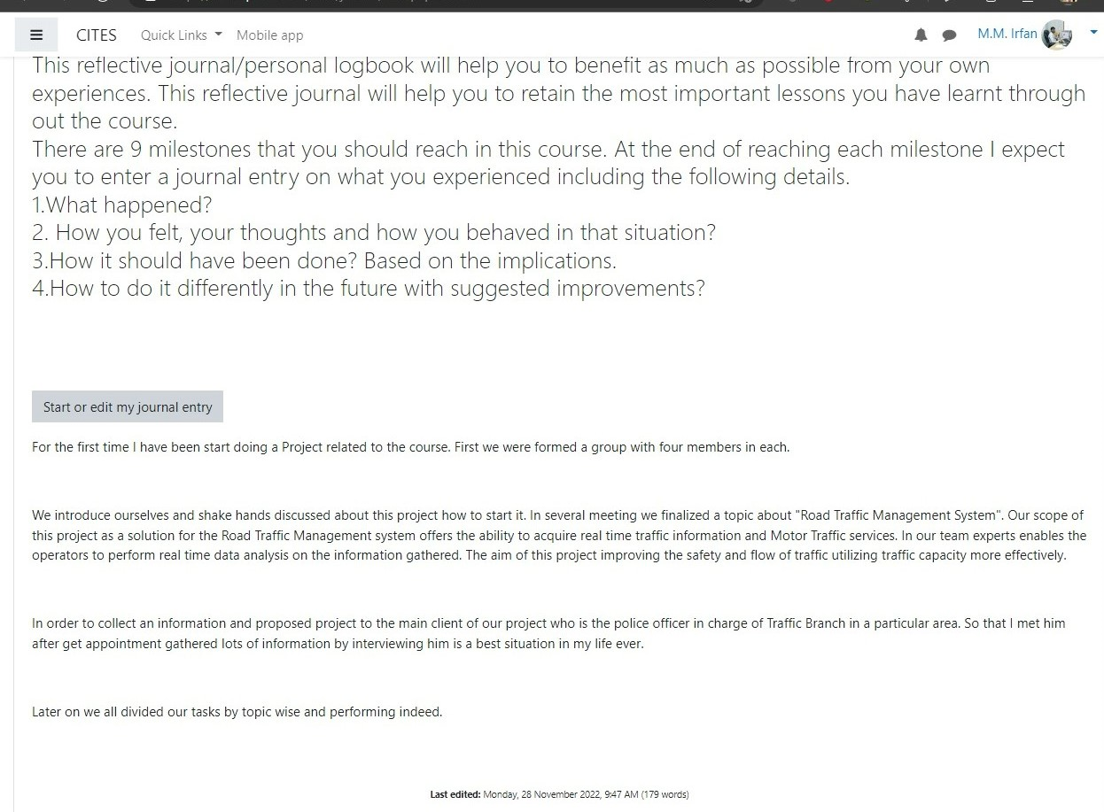
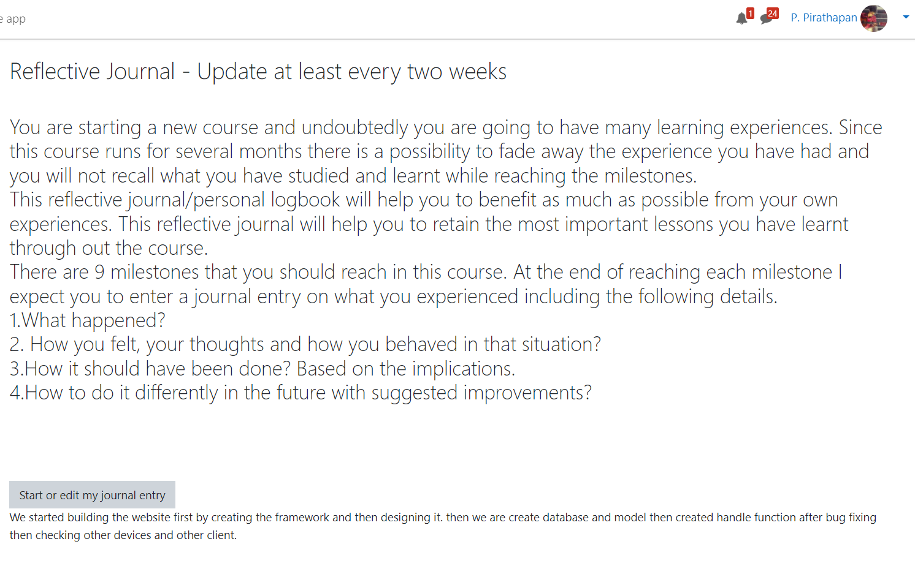
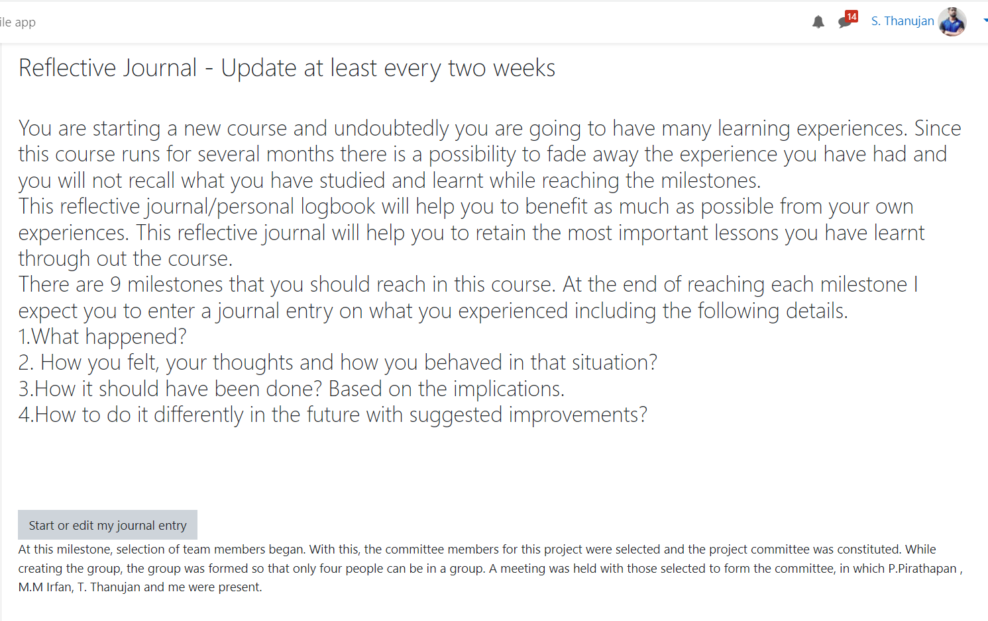
Reflective journal

Slide 8
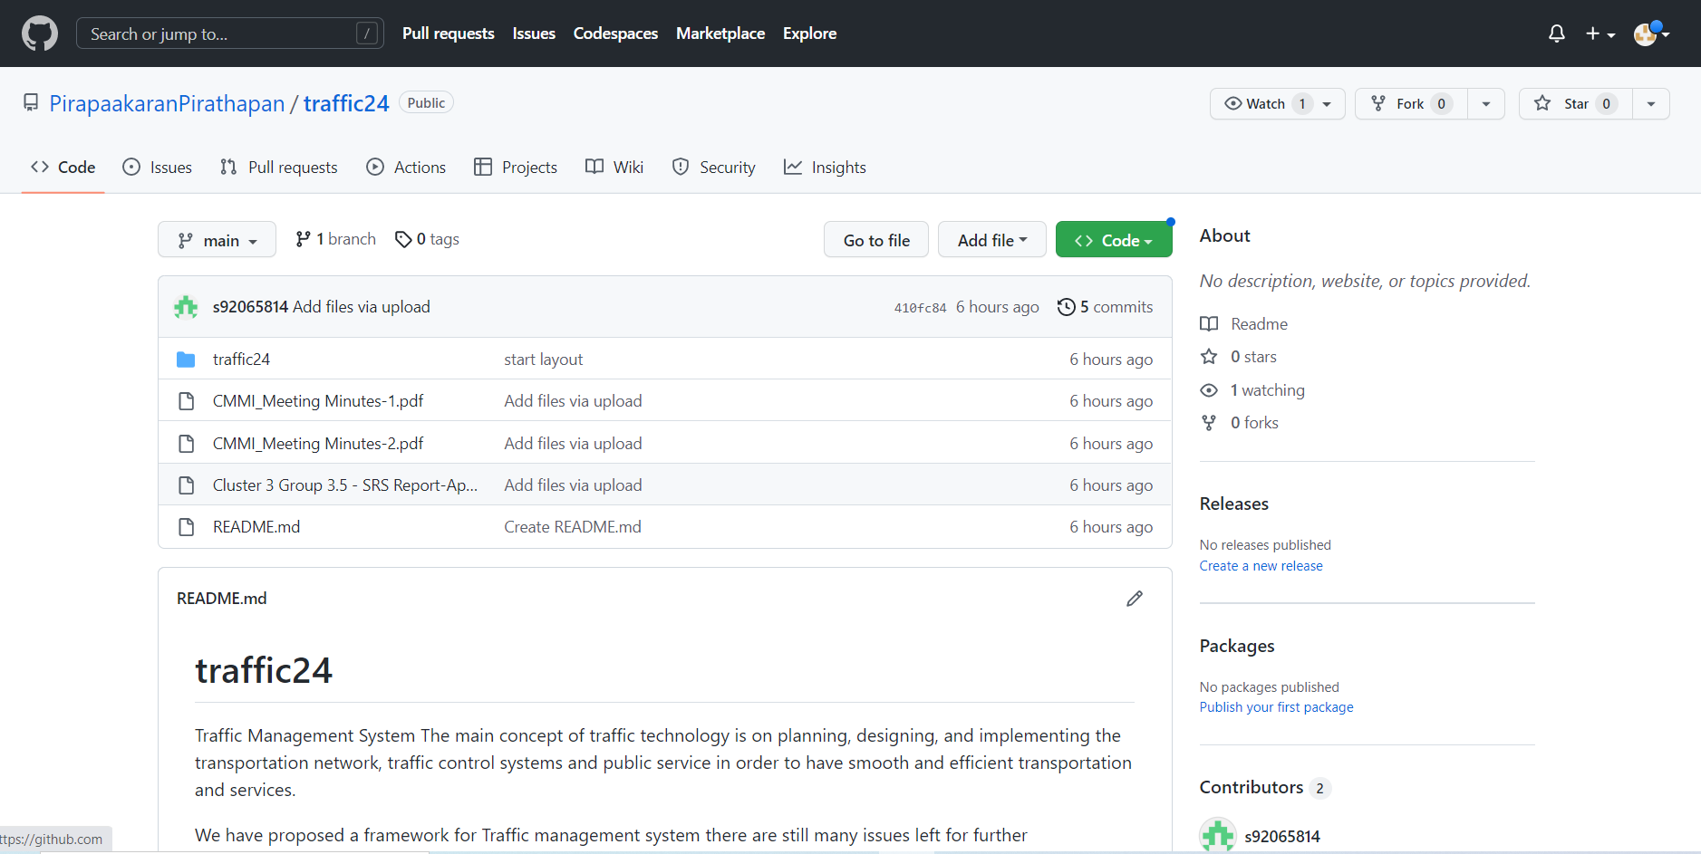
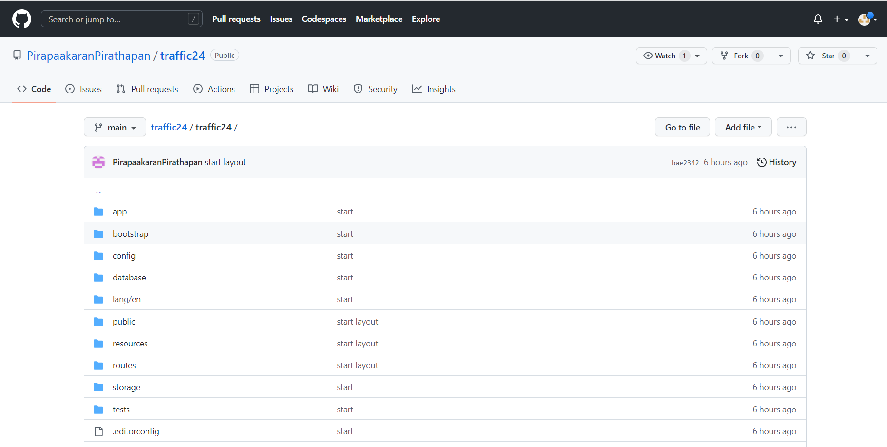
Management of GIT repository
Git is an open-source software used for tracking project changes and revisions across different teams.
Git saves different versions of projects in a folder known as a Git repository.

Slide 9
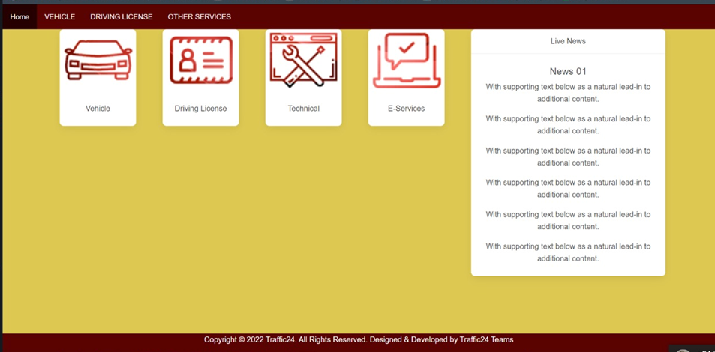
Project Implementation
Planning
Designing and developing our system was divided among team members.
2. Project Analysis
procedures for implementing the project were discussed among the team members.
3. User Interfaces
The user interface must fulfil ergonomic requirements of Live traffic news.
The design and layout of every form will be very clear and very interactive to the administrator.

Slide 10
Functional Requirements
Functional requirements specify that the functionality of the system. In a software development environment the system’s perspective the software functionality that developers must build into the product to enable users to accomplish their tasks.
The system will show the traffics on a road graphically.
The System have capability to enter the type of vehicle for specific way or should give priority to according to given type of vehicle.
System should measure density of traffic.
System allow which way traffic will go by.
System should have ability to reduce traffic jam.
Register new User account.
The register User must be familiar with the Road traffic management system.
System must be able to verify personal information.
User Login.
Username is provided when they register.
The system must only allow user with valid username and password to enter the system.
The system performs authorization process which decides what user level can access.
Update profile.
Input Name in characters, email and password in alpha numeric value, mobile number profile picture, date of birth Processing Storing the values entered, in the database Output Confirmation message profile updated successfully.
User Logout.
The user must be able to logout after they finished system.

Slide 11
Non Functional Requirements
Non-functional requirement play a significant role in the development of the system. If nit captured properly, the system may not fulfill some of the basic business needs.
Availability
System should be available every time and on every window it should support.
Reliability
System should he reliable enough to satisfactorily the performance.
Supportability
It should provide support to user to easily access all the pages without much effort and it should be capable to update and maintain in future.
Maintainability
System should be easily maintainable. It should be flexible enough tis stand with change and exceptions. The system should also handle new requirements. It should have capability to maintain in new environment.
Usability
System should be user friendly and should provide informative error message to inform user when something goes wrong.
Security
Security is the main issue. System should be safe and ensure the security. It will ensure secure transfer of data.

Slide 12
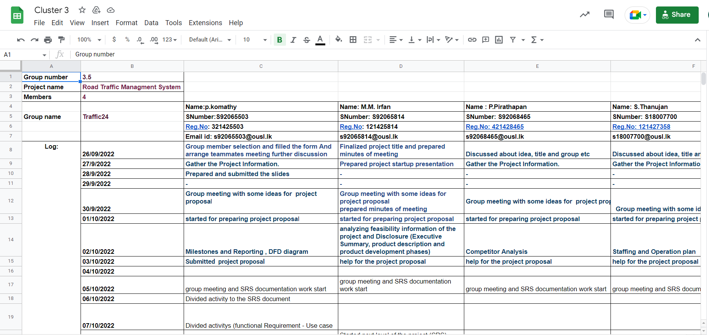
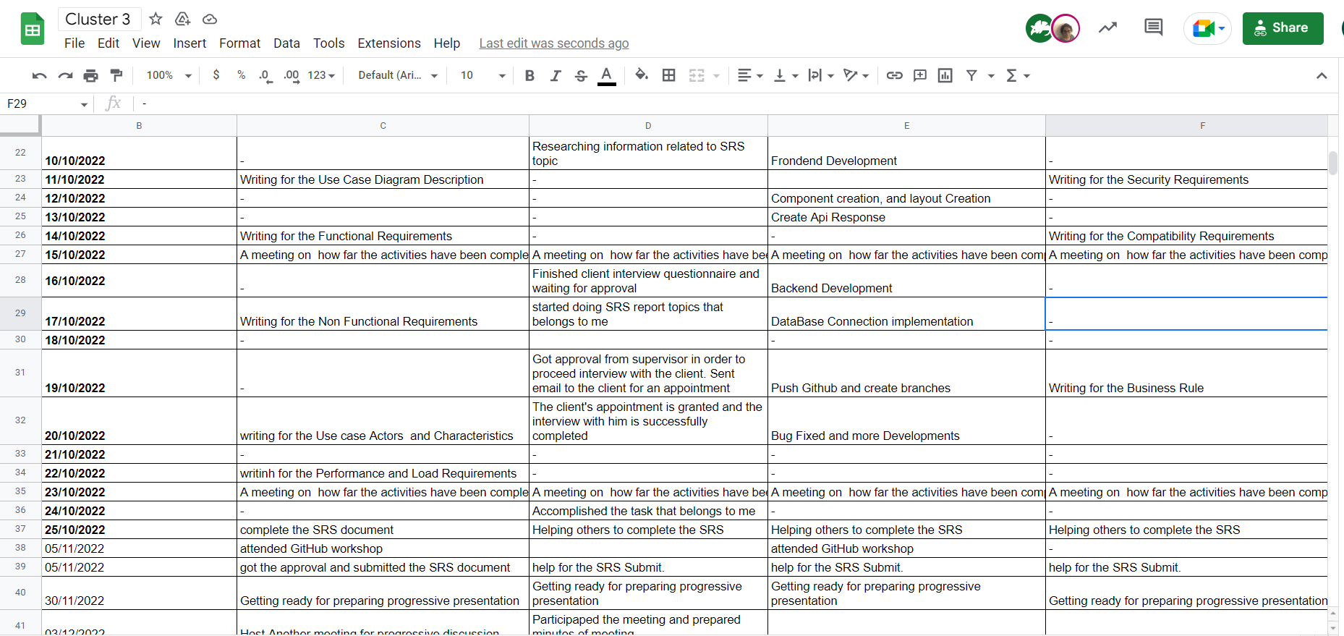
Use of project Governance tool

Slide 13
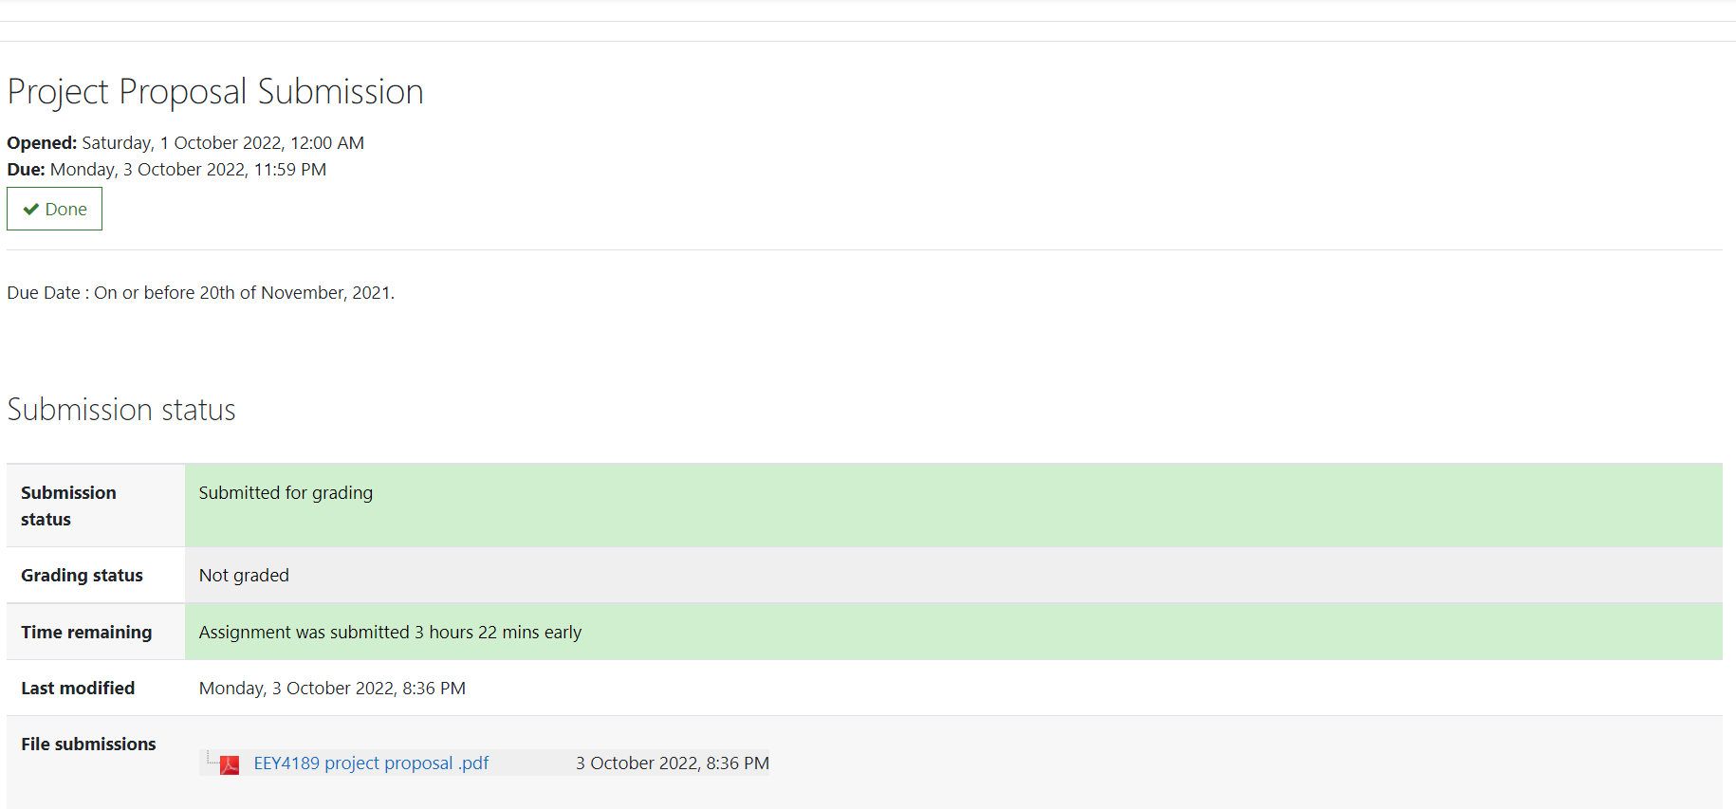
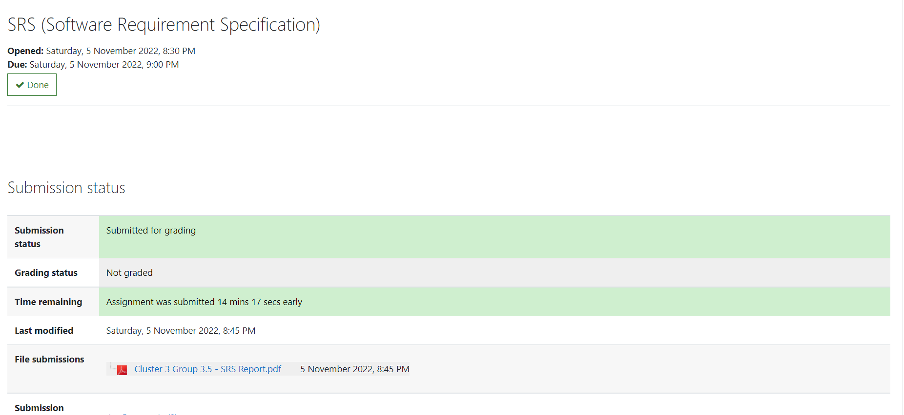
Submission of required documents (Project Proposal, SRS, Progress Review Presentation)
Documents like Project Proposal, SRS were submitted within due time.
Documents | submitted | Not submitted
Project Proposal | √
SRS | √
Progress Review Presentation | √

Slide 14
Conclusion
Collaboration and Teamwork – All our team members successfully completed the divided projects.
We have completed each and every task of our project in a phased manner as per the Milestone.
We can all benefit from using our Project Road Traffic Management System to address the biggest threat of Current time.

Slide 15
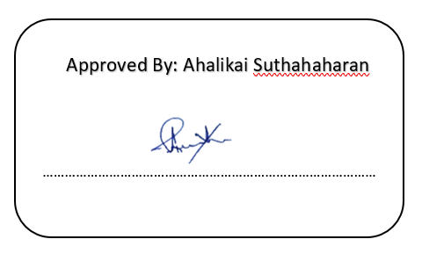
Thank You.

